Slide 1

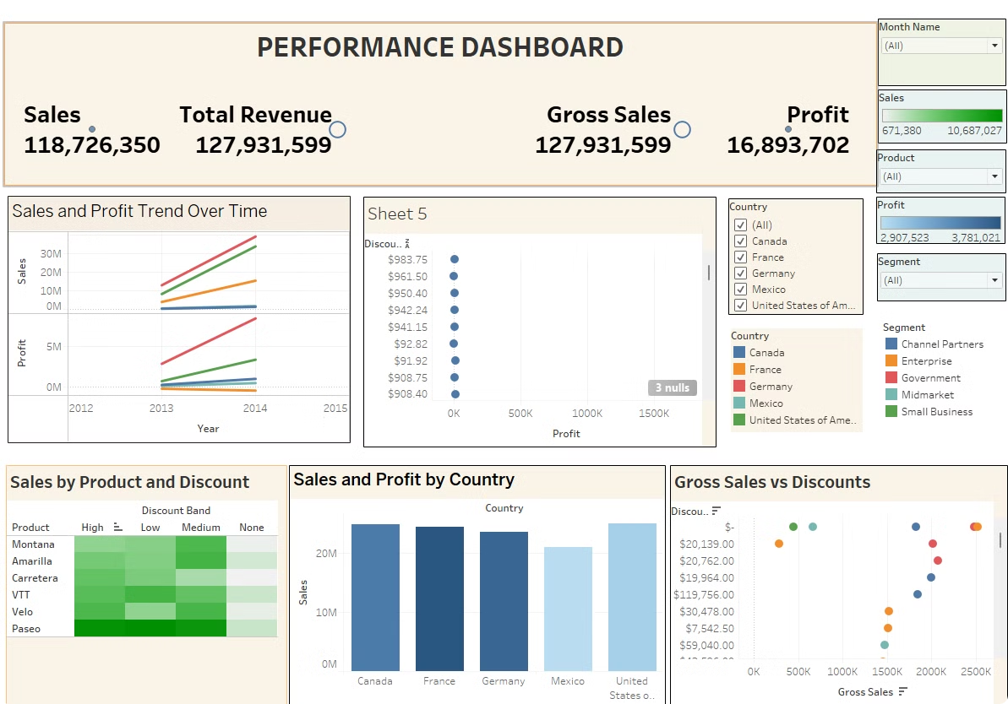
Financial Performance Dashboard
This presentation showcases this Tableau project is to analyze financial performance across different countries, products, and time periods, using key financial metrics such as sales, profit, cost of goods sold (COGS), and discounts
By:
S.Sumith kumar
UNID:UMIP19852

Slide 2
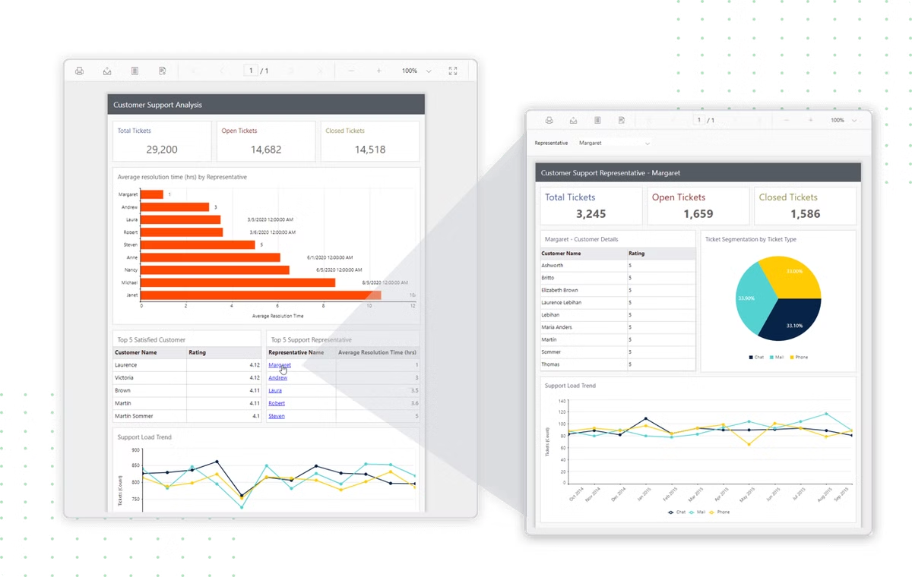
Report Structure Overview
Data Slicing
Key Metrics
the data here is filered by Segement,country , product name and month
Total revenue, Total Sale, Total Profit
Charts
Insights
Sales and Profit Trend Over Time and Sales and Profit by Country
Gain valuable like sales over trends

Slide 3


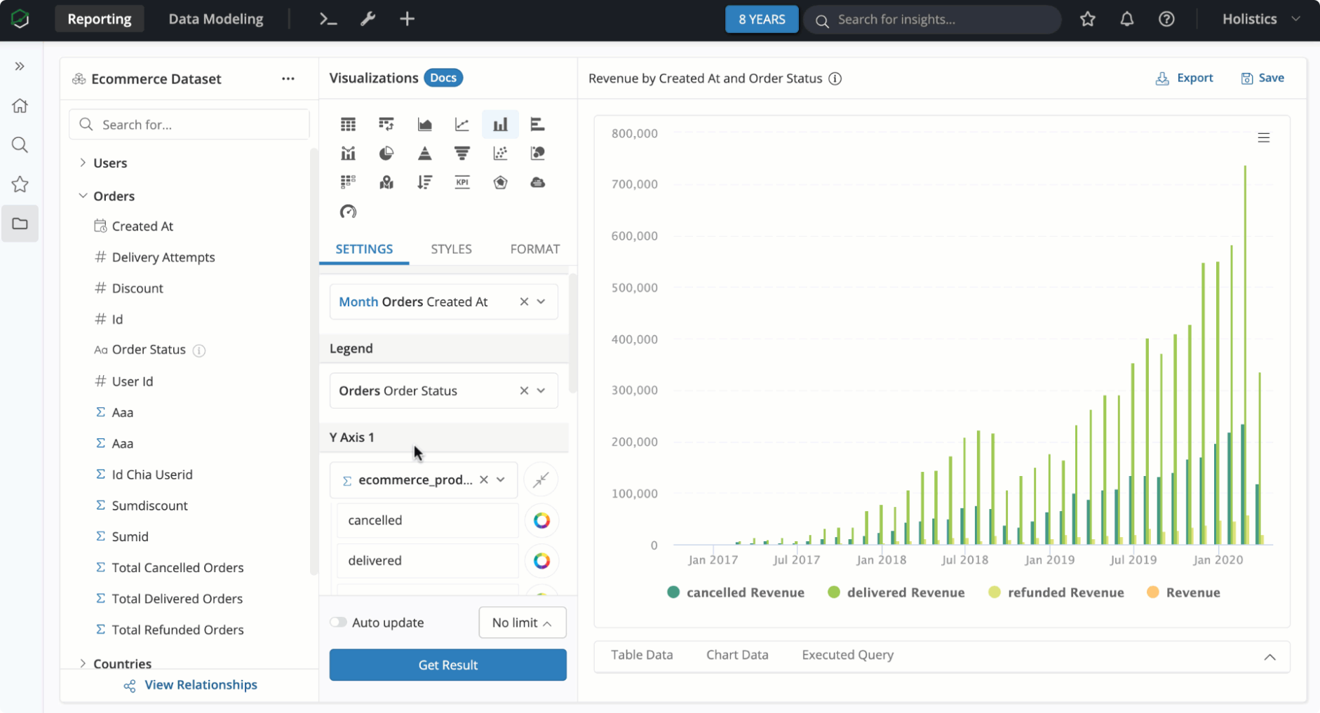


Data Slicing by Segments, Country, and Year
Segments
Analyzed performance across different market segments like Channel Partners ,Enterprise ,Government ,Midmarket, Small Business
Country
Compare sales and profits across various countries like canada , france, germany etc.
Year
Tracked yearly performance and identify trends.

Slide 4
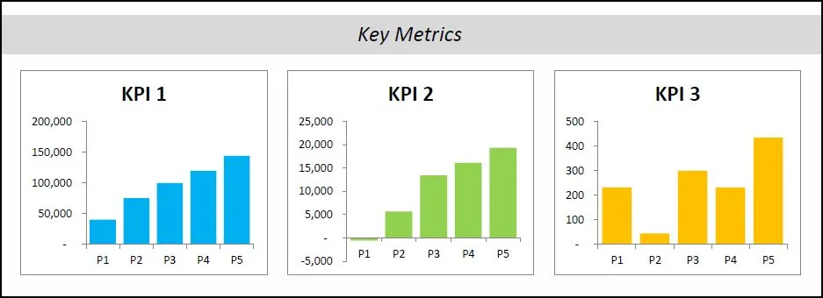
Key Metrics: Total revenue, Total Sale, Total Profit
Total Revenue
Sales
Profit
Total Revenue overall time period
Total revenue generated from sales.
Net profit after deducting all expenses is 16,893,702
127,931,599
118,726,352

Slide 5

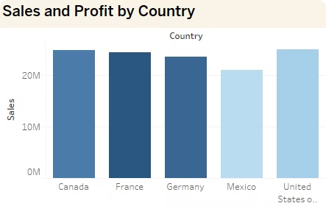
Sales and profits by country:
1
Observations from the bar chart:
The bar chart "Sales and Profit by Country" presents a clear visual comparison of sales performance across five countries: Canada, France, Germany, Mexico, and the United States. The chart reveals that the United States and Canada are the top performers, with sales figures exceeding 25 million. France and Germany follow closely, with sales ranging between 23-24 million. Mexico, on the other hand, lags behind with the lowest sales figure of approximately 21 million. The chart also suggests a notable gap between the top three countries (United States, Canada, and France) and the bottom two (Germany and Mexico).

Slide 6

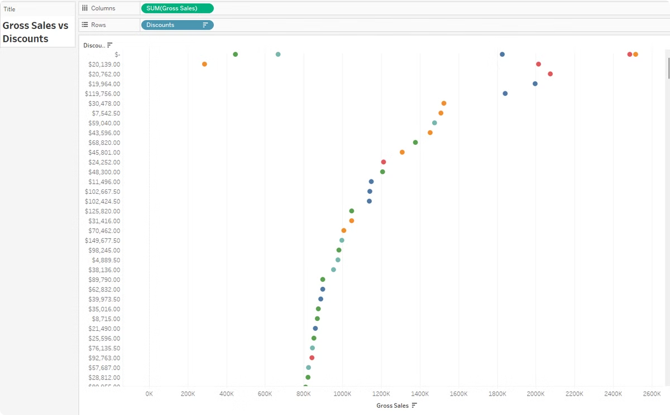
Gross Sales vs Discounts
1
Based on the scatter plot chart "Gross Sales vs Discounts", the following observations can be made:
Majority of sales are concentrated in the lower to mid-range gross sales: The majority of data points are clustered between 80K and 160K on the gross sales axis, indicating that most sales fall within this range.
Discounts are not strongly correlated with gross sales: The data points are scattered without a clear pattern, suggesting that there is no strong linear correlation between gross sales and discounts.
Outliers indicate potential anomalies or opportunities: The outliers, such as the two red dots at the far right of the chart and the green dot at 500K gross sales, may represent unusual sales patterns or opportunities that warrant further investigation.

Slide 7


Insights and Observations
The dashboard reveals key trends and patterns. These insights can inform strategic decision-making.
Based on the comprehensive performance dashboard, the following insights and observations can be made:
Sales and Profit Trend: The line graph shows an overall upward trend in sales and profit from 2012 to 2015, indicating a positive growth trajectory for the business.
Product Performance: The heat map "Sales by Product and Discount" suggests that different products have varying sales levels across different discount bands. For example, Montana and Amarilla appear to have higher sales in the "High" discount band, while Carretera and VTT have higher sales in the "Medium" discount band.
Country-wise Performance: The bar chart "Sales and Profit by Country" indicates that Canada, France, and Germany are the top-performing countries in terms of sales. This could inform decisions on market focus and resource allocation.
Discount Strategy: The scatter plot "Gross Sales vs Discounts" shows a wide range of discounts, from $7,500 to $120,000, with no clear correlation between gross sales and discounts. This may suggest that the discount strategy is not solely based on sales volume.
Profit Range: The profit range of 2,907,523 to 3,781,021 indicates a relatively stable profit margin, with some fluctuations.

Slide 8

Name:S.Sumith kumar
By:
S.Sumith kumar
UNID:UMIP19852
UNID:UMIP19852

